Slide 1
PMOD2BNC
ArtyS7 Peripheral PCB Design

Slide 2

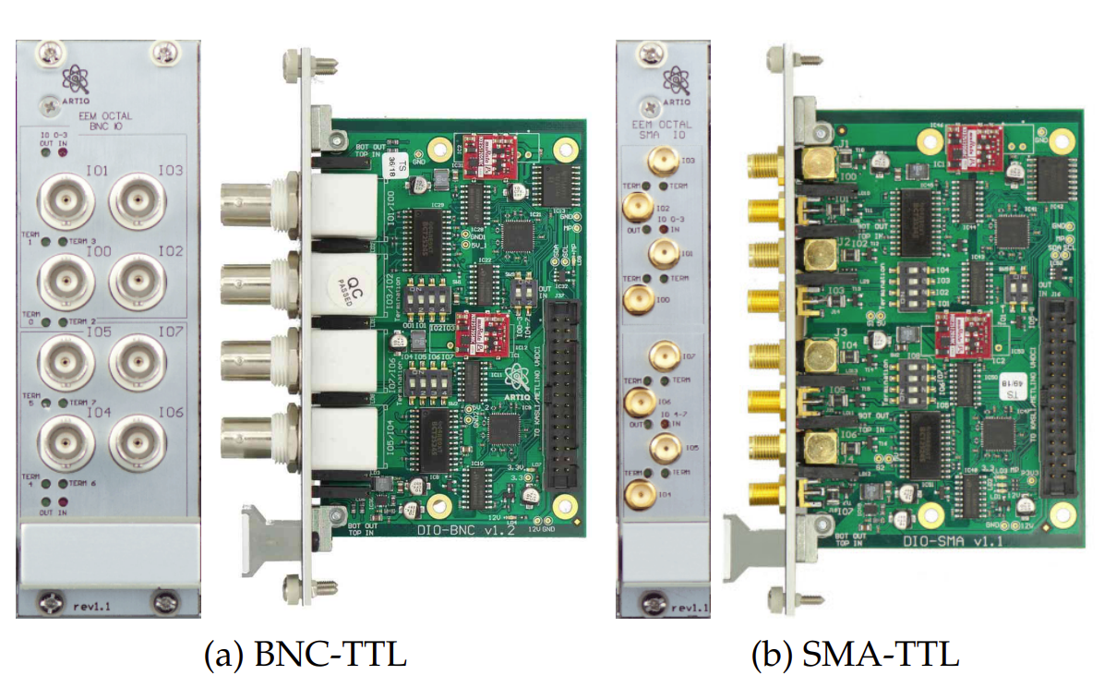
Used Tools & Referenced Board
Cadence Orcad 16.6
M-labs TTL board

Slide 3
Difference
 | QuIQCL | M-labs
IO impedance | 50/High Z Selectable | 50/High Z Selectable
Output Voltage | 3.3/5 V Selectable | 5V
Minimum Pulse Width | ~150Mbps | ~3ns
Supply Voltage | 3.3V from FPGA 12V from External | 12V from FPGA(Kasli)
Output Port Type | BNC | BNC/SMA
Isolation | Yes | Yes

Slide 4
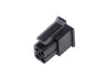
Simplified Architecture
SPDT
Voltage Select
5V
Isolator
3.3V
molex pin
BNC
Isolator
Transceiver
ESD
50 Ohm

Slide 5
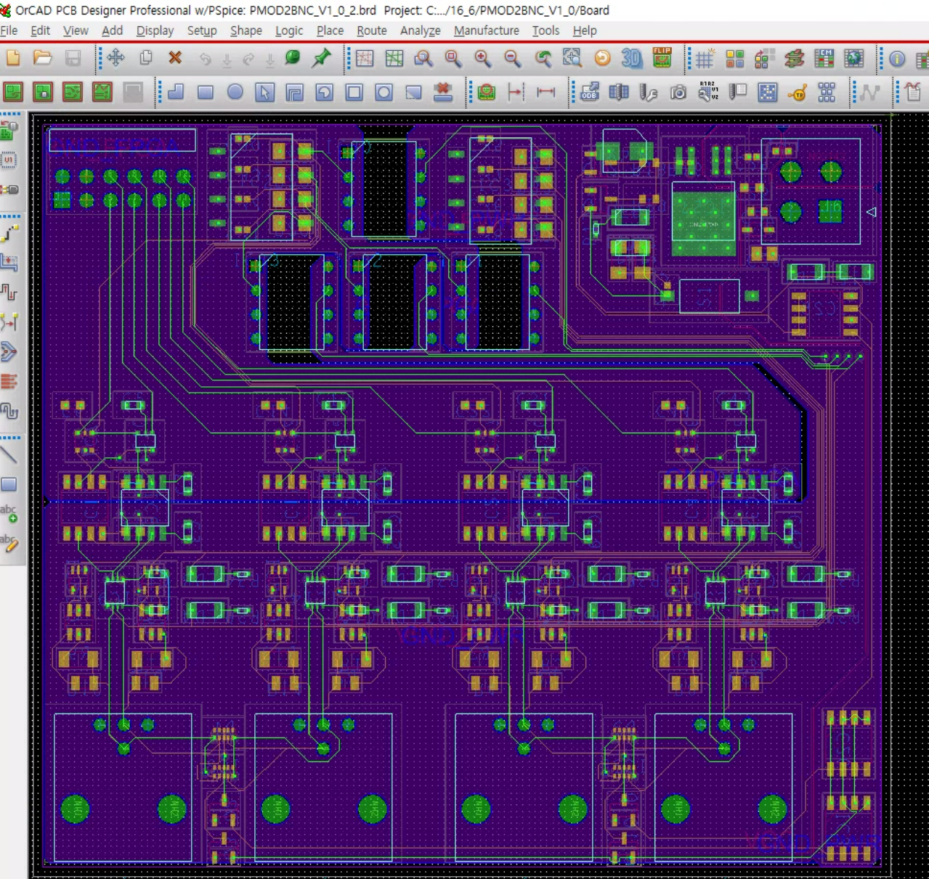
Current Progress

Slide 6
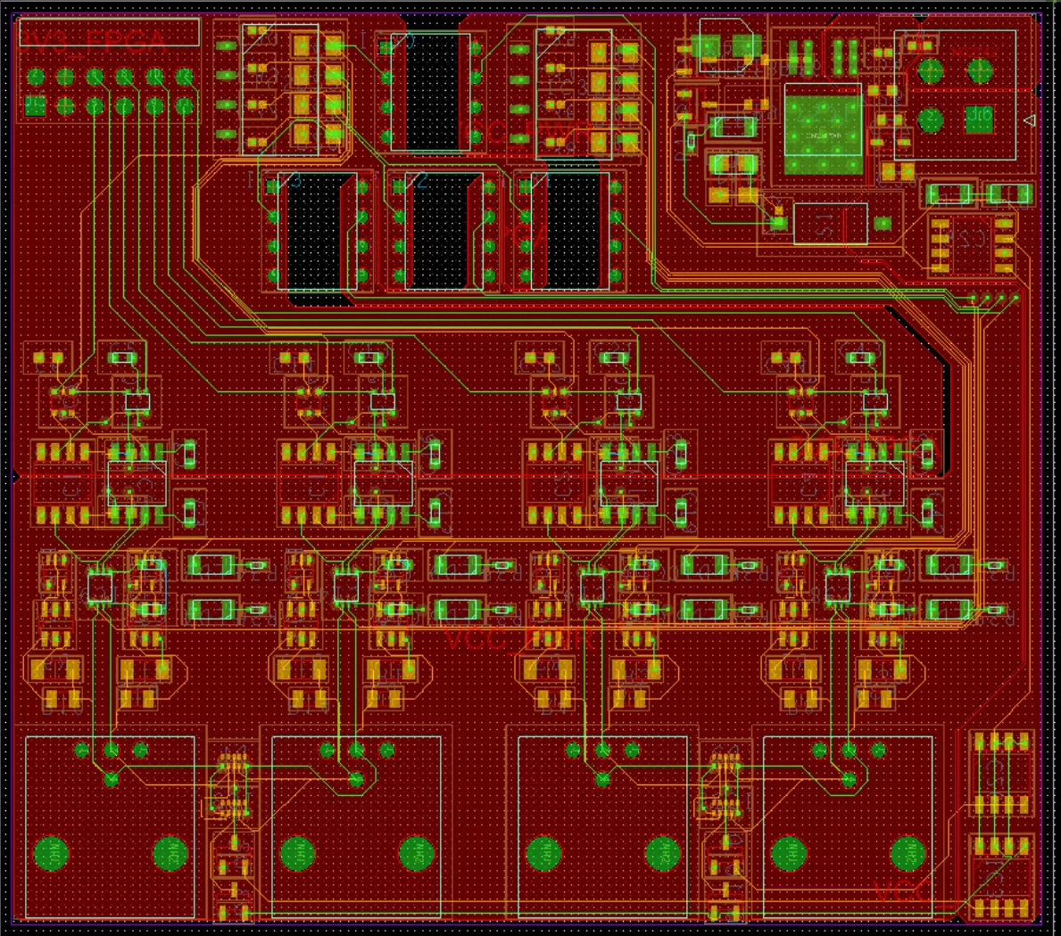
VCC Separation due to Current

Slide 7
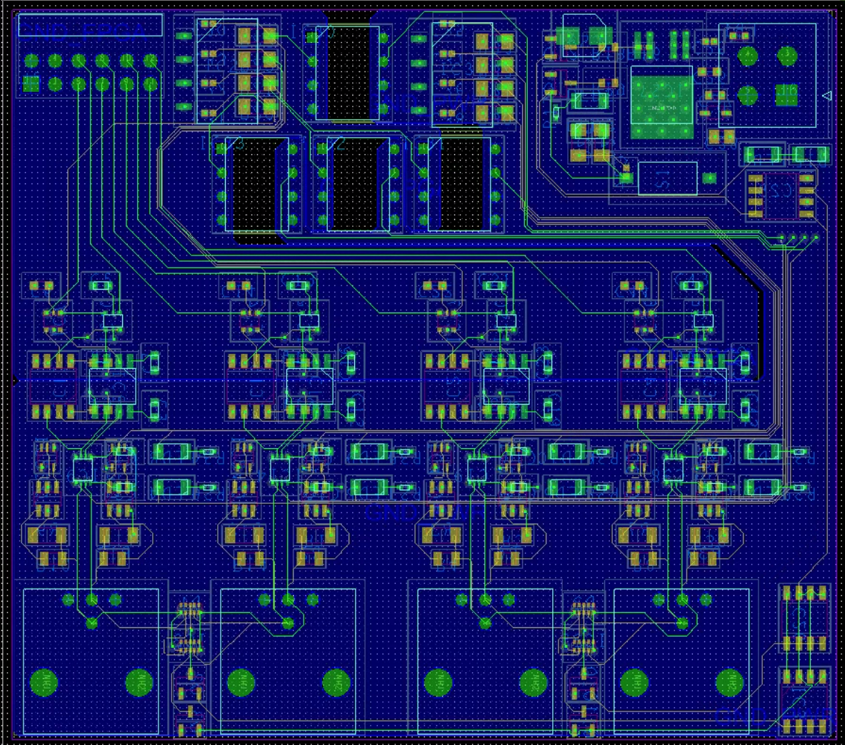
GND Seperation

Slide 8
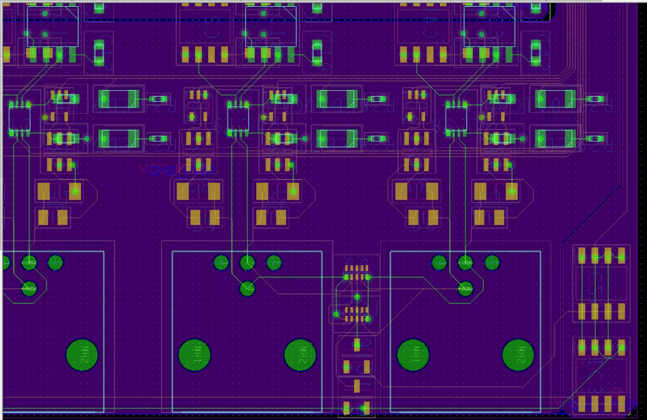
Termination

Slide 9
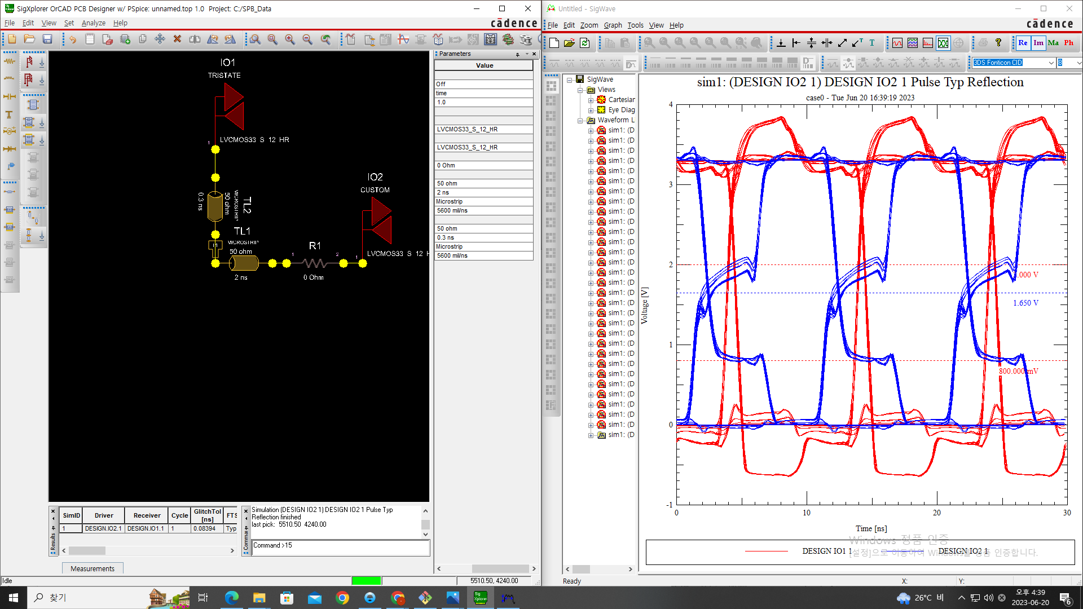
Without Termination

Slide 10
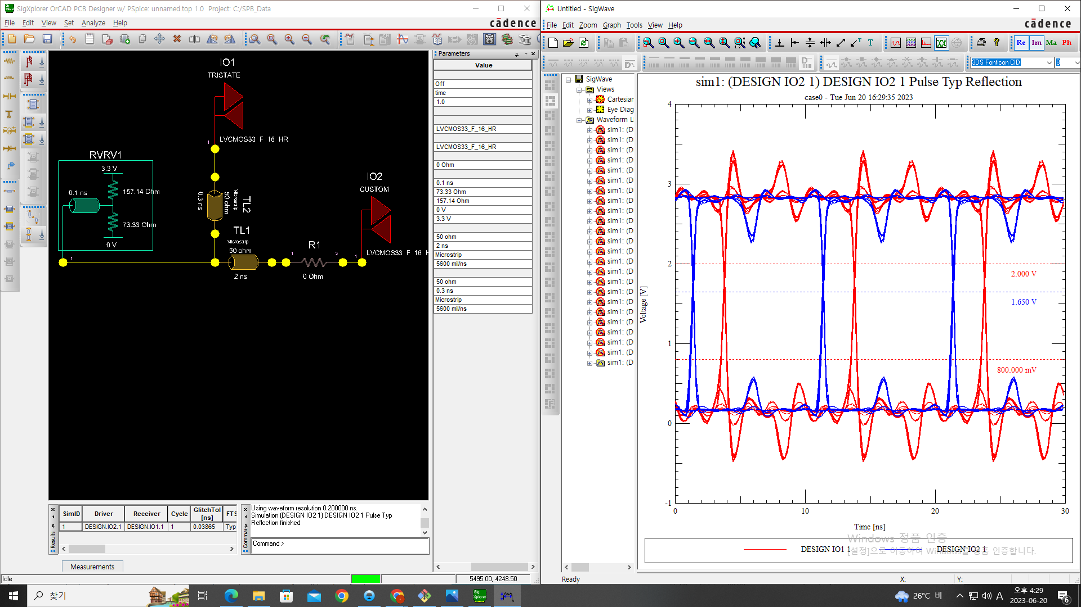
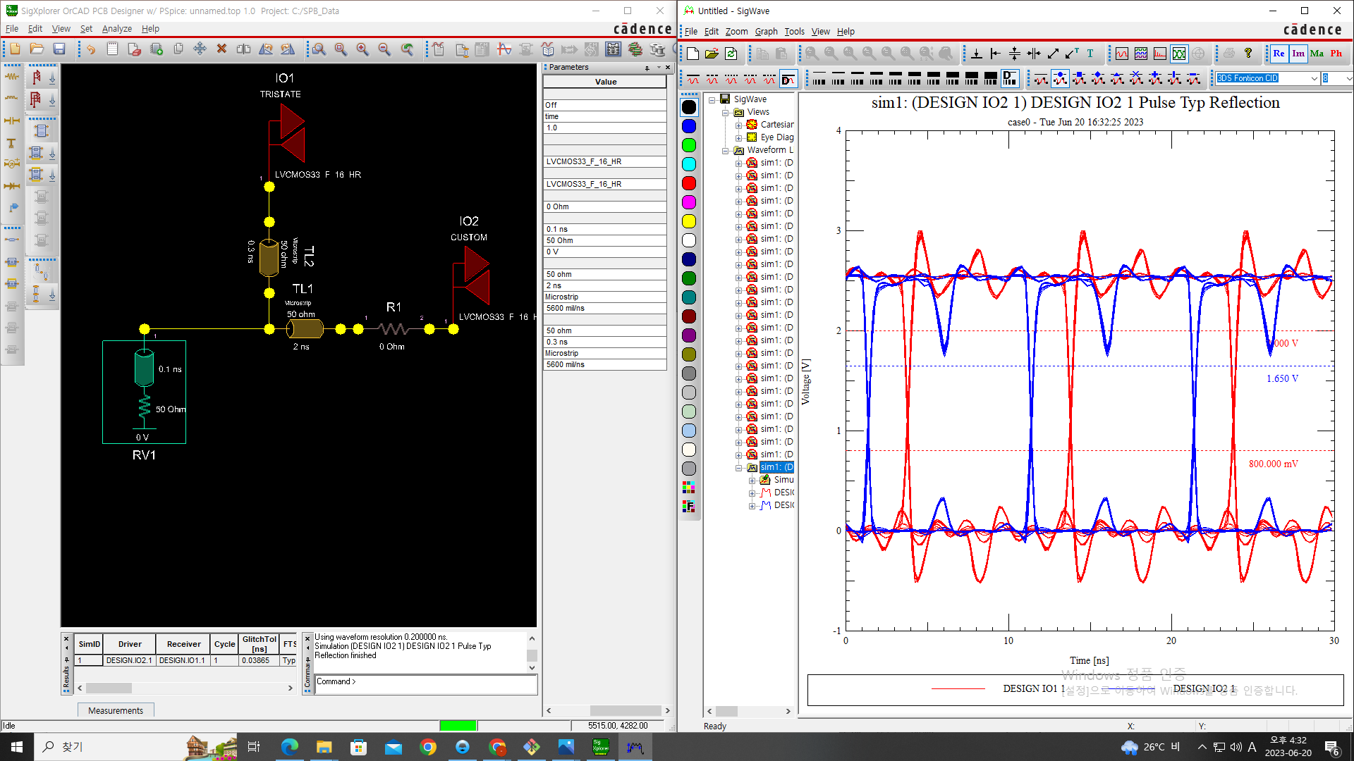
With Termination
Thevnin Termination
Parallel Termination

Slide 11
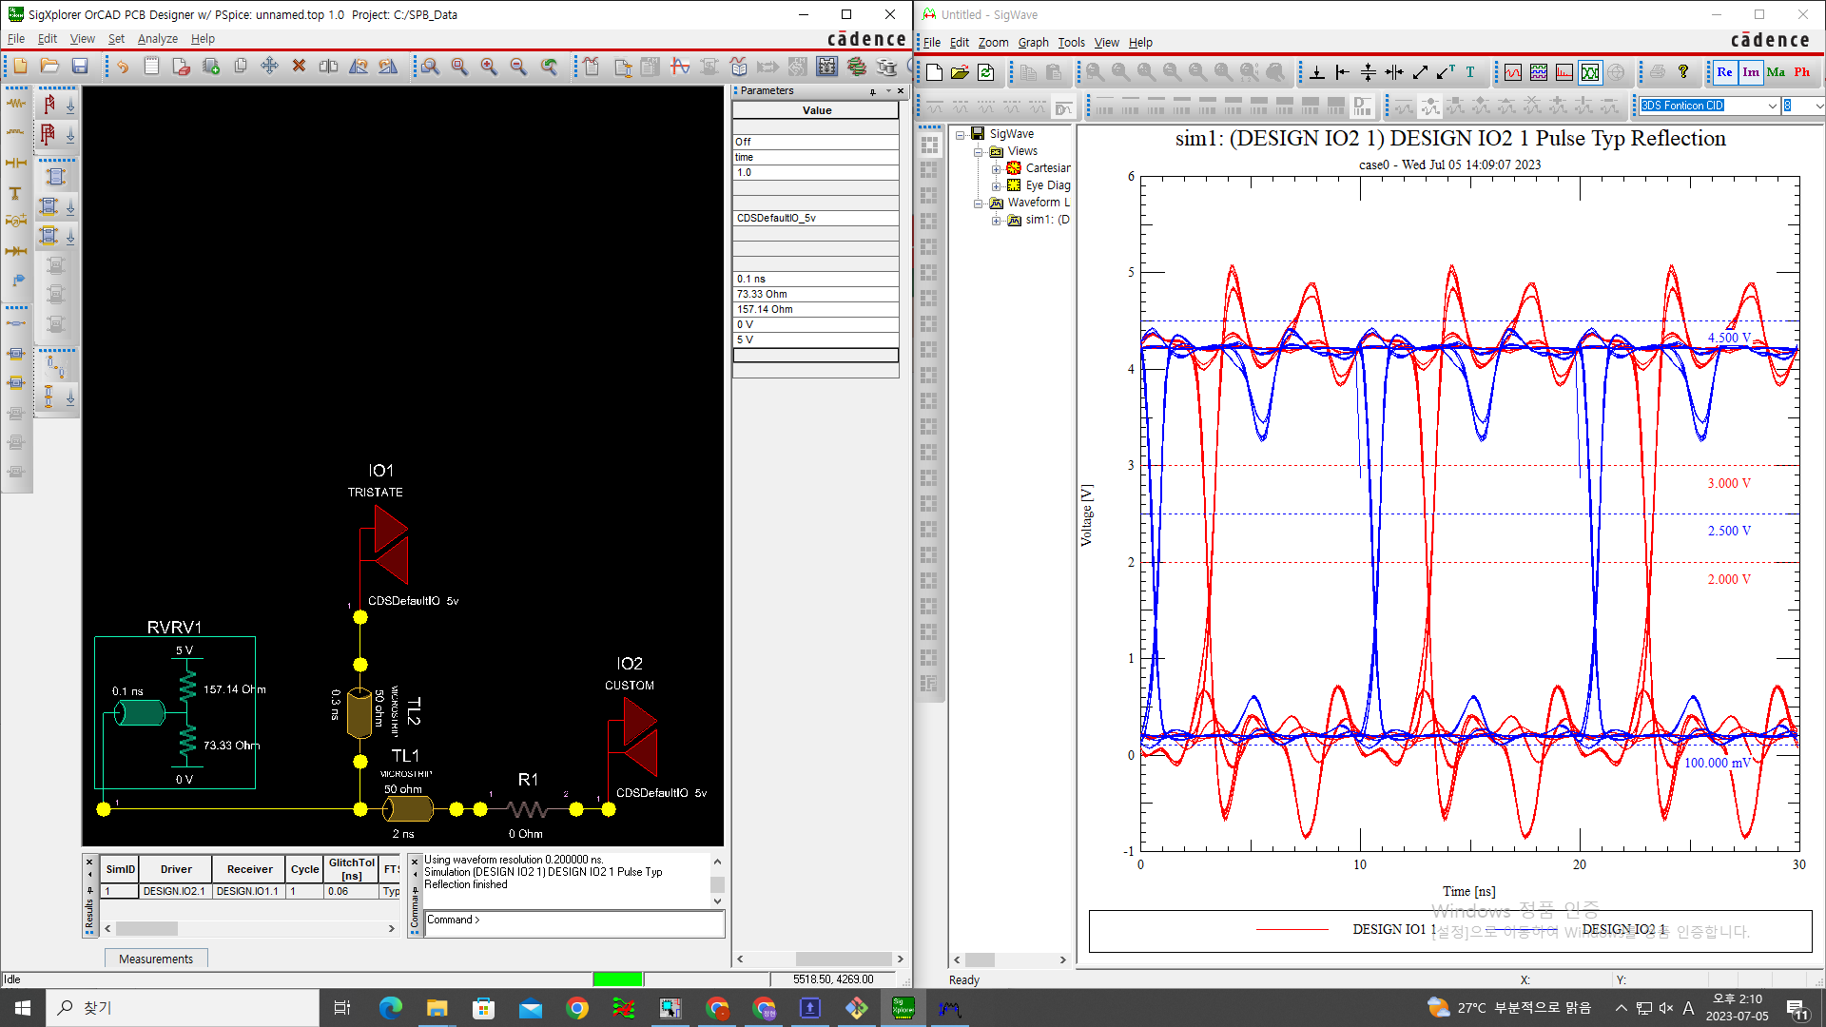
3.3V, 5V comparision
3.3V Thevnin Termination
5V Thevnin Termination

Slide 12
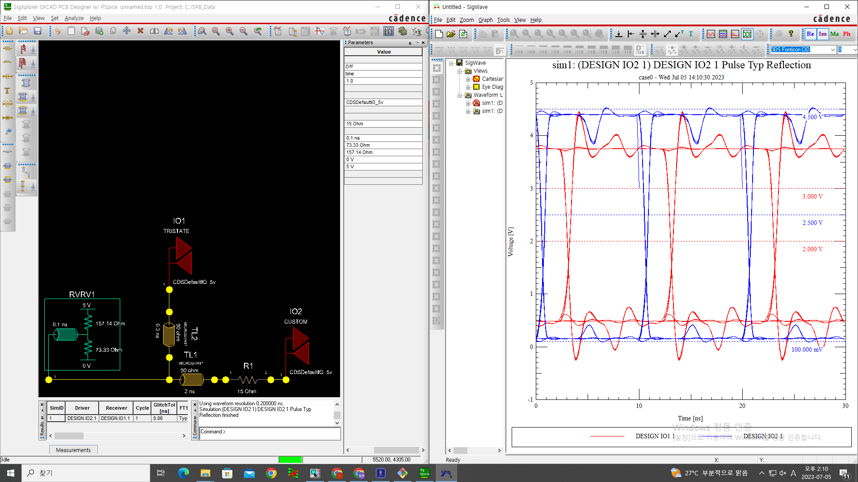
Source Impedance Comparision
w/o source impedance
w/ 15Ohm source impedance

Slide 13
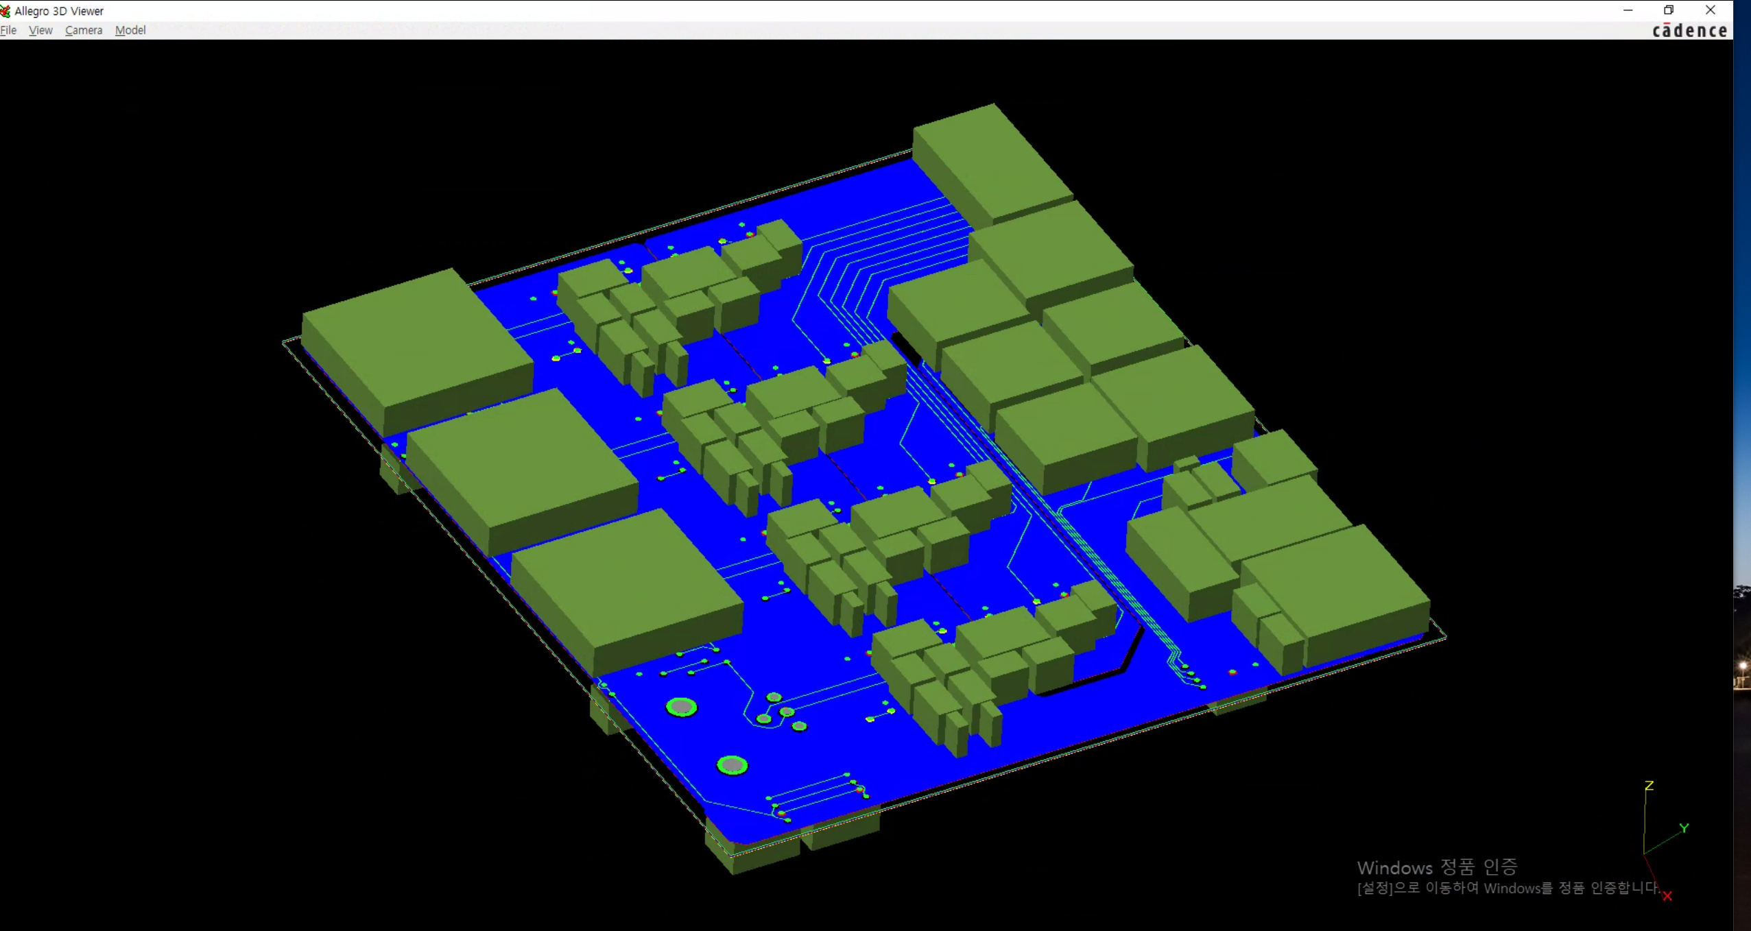
In 3D

Slide 14
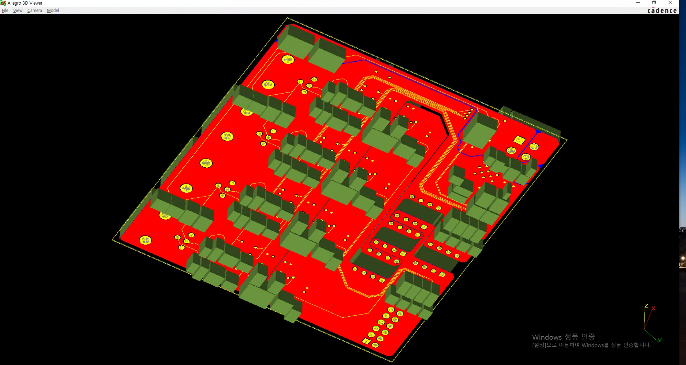
In 3D

Slide 15
ToDo
Delay tuning
PCB thickness setting

Slide 16
Rev 3
Regulator 12V0 TO 3V3
(LD29150DT33R)
Regulator 12V0 TO 5V0
(LD29150DT50R)
Voltage
Switch
EXT PWR PIN
(462071104)
LED Diode
(598-8260-107F)
LED Diode
(598-8260-107F)
12V0 ESD
(PE3212M1Q_R1_00001)
X2
2.2+5.3+3.1+8.8
=19.4mA, 150mW
NFET
(NVR4501NT1G)
IO SPDT
Impedance SPDT
Ground Isolation
3V3 ESD
(UCLAMP3301H.TCT)
5V0 ESD
(PRTR5V0U2X,215)
3.3V Source
Isolator
2->2
(SI8620BC-B-IS)
Transciever
2<->2
(74LVCH2T45DC-Q100H)
100mA, 250mW
Transistor
(LIB_NTGD4167CT1G)
Digital SPDT
(74LVC1G3157GW,125)
Isolator
2->2
(SI8620BC-B-IS)
157.14Ohm
(ERA-8AEB1580V)
Molex
Pin Header
(71764-0112)
50Ohm
BNC
(031-6575)
Transciever
2<->2
(74LVCH2T45DC-Q100H)
Digital SPDT
(74LVC1G3157GW,125)
Isolator
2<-2
(SI8620BC-B-IS)
73.33Ohm
(RP73PF2A73R2BTDF)
Invertor
(NLVHC1G14DFT1G)
Transistor
(LIB_NTGD4167CT1G)
Isolator
2<-2
(SI8620BC-B-IS)

Slide 17
SPDT Structure
SPDT
(DS04-254-2-04BK-SMT)
X4
10KOhm
(RNCP1206FTD10K0)
100nF
(MSRLJ103SB5104MFNA01)

Slide 18
LED
1KOhm
(RNCP1206FTD1K00)
LED Diode
(598-8260-107F)

Slide 19
Voltage Switch
PFET
(NTR3A052PZT1G)
Switch
(DS04-254-2-01BK-SMT-TR)
Invertor
(NLVHC1G14DFT1G)
PFET
(NTR3A052PZT1G)
10KOhm
(RNCP1206FTD10K0)
100nF
(MSRLJ103SB5104MFNA01)

Slide 20
Decoupling Capacitor (@ IC VCC pin)
10uF (Electro)
(MAL215375109E3)
Sizes should considered!!! in 100 nF (8501 ... etc)
Look : https://www.renesas.com/us/en/document/apn/an1325-choosing-and-using-bypass-capacitors
-> L effect considered
1uF (Ceramic)
(KAM03CT70J105KH)
100nF (Ceramic)
(MSRLJ103SB5104MFNA01)
10nF (Ceramic)
(MAASL063SB7103MFCA01)

Slide 21
Bypass Capacitor (@ power source)
1nH(Ferrite Bead)
(BLM18PG121SN1D)
1uF (Ceramic)
(KAM03CT70J105KH)
100nF (Ceramic)
(MSRLJ103SB5104MFNA01)
10nF (Ceramic)
(MAASL063SB7103MFCA01)

